Slide 1
إدارة المشروعات الهندسية Engineering Project Management الفصل الخامس: هات 213 Lecture3: Project Planning Reference: Industrial Project Management, Concepts, Tools and Techniques (2007)

Slide 2
Project Planning Elements Review..
The project plan has seven essential elements:
1. Needs, goals, objectives, and requirements
2. Task statements, statement of work, and work breakdown structure
3. Technical approach
4. Schedule
5. Organization, staffing, and task responsibility matrix
6. Budget
7. Risk analysis

Slide 3
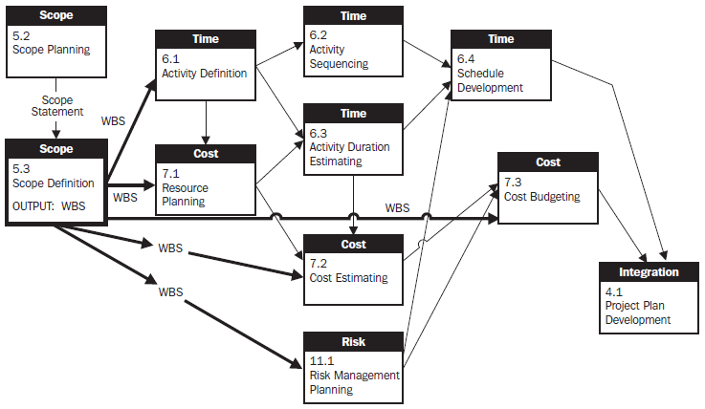

Slide 4
Technical Approach
The technical approach is a task-by-task description of how the project team intends to execute the tasks and subtasks in the project charter, from a technical perspective.
Selected Questions for Technical Approach
1. How do we plan to execute this task/subtask?
2. What is special or unique about our approach?
3. What technology do we plan to utilize or transition?
4. How can we be most productive and efficient?
5. What computer tools will we be using?
6. How can we demonstrate that we will, as a minimum, satisfy all customer requirements?

Slide 5
Technical Approach
7. Are certain requirements vague, incorrect, or inconsistent?
8. What special facilities will we need?
9. What is our approach to system and subsystem testing?
10. What specialty engineering capabilities will we be using?
11. What types of technical support will be needed from the rest of the company?
12. How will we find the most cost-effective solution?

Slide 6
Schedule : project time management
Before the project schedule can be created, the team must identify the activities, and determine all of the interdependencies.
Two main methods of describing a schedule are in use today, namely, (1) a Gantt Chart and (2) a program evaluation and review technique (PERT) Chart.
The Five Time-Management processes:
1. Activity definition,
2. Activity sequencing,
3. Activity duration estimation,

Slide 7
The Five Time-Management processes:
4. Schedule development, building a logic diagram to illustrate the activity flow, and then overlaying the diagram onto a calendar, once the start date is known.
5. Schedule control, Once the schedule has been developed and approved, the work can begin. In order to ensure that all critical dates are met, it is necessary that someone monitor the activity completions, and take any required action to get things back on track if problems occur.

Slide 8
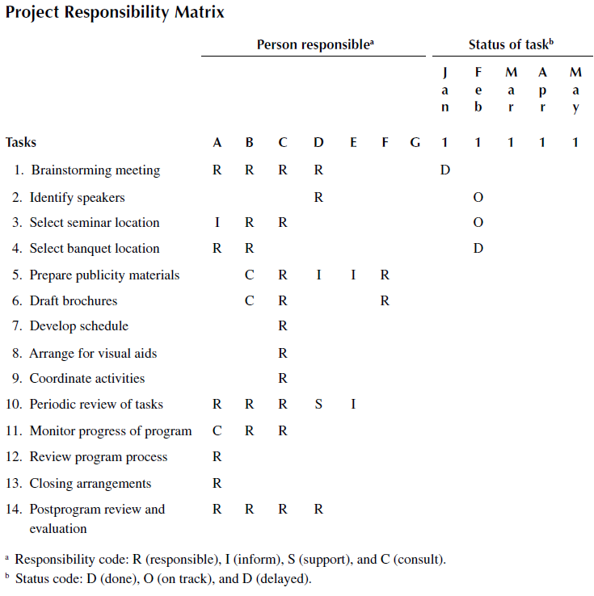

Slide 9
CPM SCHEDULING
Project scheduling is often the most visible step in the sequence of steps of project management. The two most common techniques of basic project scheduling are the critical path method (CPM) and program evaluation and review technique (PERT).
CPM network analysis procedures originated from the traditional Gantt chart, or bar chart.
CPM network analysis is implemented in three phases:
Planning phase, the required activities and their precedence relationships are determined.
Scheduling phase, forward-pass and backward-pass computations.
Control phase, tracking the progress of a project.

Slide 10
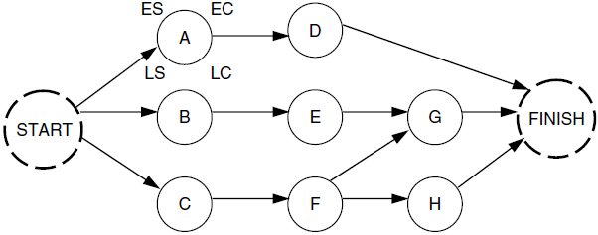
CPM
The project activities are represented in the form of a network diagram. The two popular models for network drawing are the activity-on-arrow (AOA) and the activity-on-node (AON).
AON example:

Slide 11
CPM
The primary goal of CPM analysis is to identify the “critical path,” which is a determination of the minimum completion time of a project. The computational analysis involves both forward-pass and backward-pass procedures. The forward pass determines the earliest start time and the earliest completion time for each activity in the network. The backward pass determines the latest start time and the latest completion time for each activity.
Network notations are:
A: Activity identification , ES: Earliest starting time
EC: Earliest completion time, LS: Latest starting time
LC: Latest completion time, t: Activity duration

Slide 12
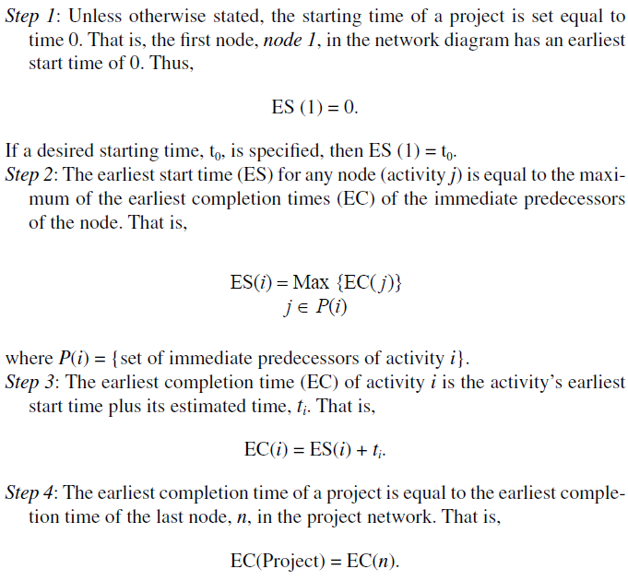
Steps of
CPM
Network
Analysis

Slide 13
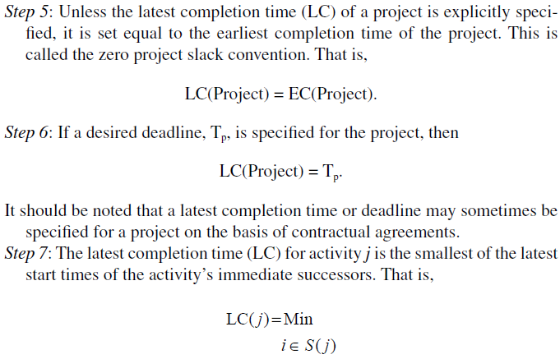
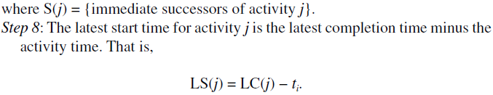
Steps of
CPM
Network
Analysis

Slide 14
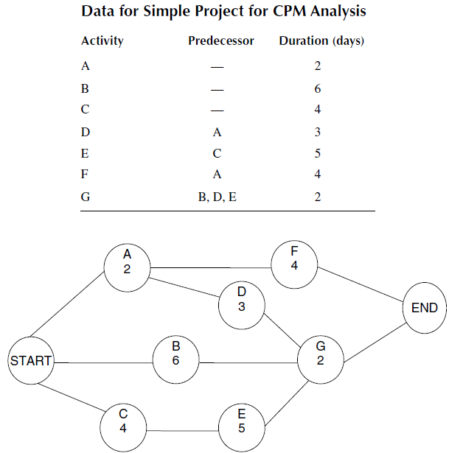
Example of activity network:

Slide 15
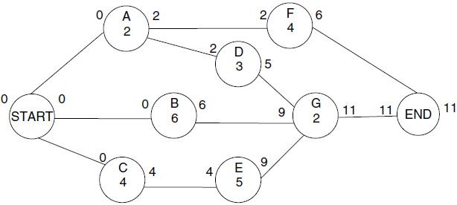
Forward Pass Analysis
Zero is entered as the ES for the initial node. As the initial node for the example is a dummy node, its duration is 0. Each node is treated as the “start” node for its successor or successors. However, if an activity has more than one predecessor, the maximum of the ECT of the preceding activities is used as the activity’s starting time. E.g. activity G’s ES is determined as Max {6, 5, 9} = 9. The earliest project completion time is the maximum of preceding earliest completion times: Max {6, 11} = 11.

Slide 16
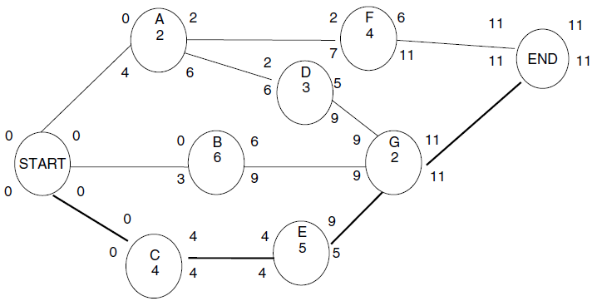
Backward Pass Analysis
9
By backtracking and using the network analysis rules, the LC and LS times are determined for each node. In the case of activity A with two immediate successors, the latest completion time is determined as the minimum of the immediately succeeding latest start times. That is, Min {6, 7} = 6. A similar situation occurs for the dummy starting node. In that case, the latest completion time of the dummy start node is Min {0, 3, 4} = 0.

Slide 17
DETERMINATION OF CRITICAL ACTIVITIES
The critical path is defined as the path with the least slack in the network. The critical path is also the longest path in the network diagram. In large networks, it is possible to have multiple critical paths. In this case, it may be difficult to visually identify all the critical paths.
Total Slack (TS) is defined as the amount of time an activity may be delayed from its earliest starting time without delaying the latest completion time of the project.
TS( j) = LC( j) − EC( j) or TS( j) = LS( j) − ES( j).

Slide 18

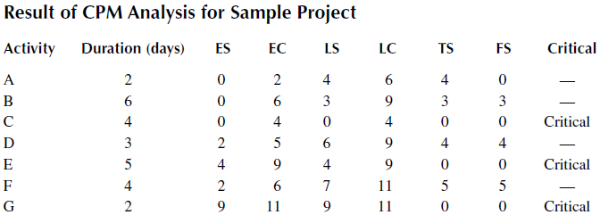
DETERMINATION OF CRITICAL ACTIVITIES
Free Slack (FS) is the amount of time an activity may be delayed from its earliest starting time without delaying the starting time of any of its immediate successors. An activity’s free slack is calculated as the difference between the minimum earliest starting time of the activity’s successors and the earliest completion time of the activity.

Slide 19
Risk Planning
A risk is a known unknown. This means that it is something that we can predict might happen, but we are not sure whether or not it really will happen.
Why? In order to avoid future difficulty.
In general, it can be said that there are four kinds of risk:
1. Technical performance risk: items of design, development, and construction of the system
2. Schedule risk: not meeting project milestones
3. Cost risk
4. Administrative risk

Slide 20
Risk Management Steps
The risk management process steps are :
Risk identification, work collectively as a team to list potential problems (Brainstorming).
2. Establishing risk management strategy: define how risks will be handled in each category
3. Assessing risk attitude (of stakeholders)
4. Risk quantification and assessment
5. Risk Response : Avoidance, Mitigation, Transfer, Acceptance
6. Inclusion of contingency: the amount of money, or the amount of time, that the PM includes in the project budget, or the project schedule, to cover for the known unknowns, or risks

Slide 21
Risk Classification and Prioritization
We may quantify risks in levels of likelihood: very low – low- medium-high-very high,
Then we can estimate the impact of these risks
and calculate the priority as the average of likelihood and impact:
Priority = (likelihood + impact)/2
For each risk identified, list the preventive actions required to reduce the likelihood of the risk occurring, as well as the contingent actions needed to reduce the impact to the project should the risk occur.

Slide 22
WORK BREAKDOWN STRUCTURE
The Work Breakdown Structure is a methodology for determining project activities by systematically breaking the project into deliverable-oriented packages.
If any activity is not in the Work Breakdown Structure, it is not in the project.
WBS is to assess WHAT is to be done (Activity Definition), and WHAT is to be produced, but not considering time (at this stage).

Slide 23
Rules of creating the breakdown:
The WBS in totality identifies all project components and deliverables.
The WBS ensures there are no gaps or overlaps.
The top levels must be deliverable-oriented
Elements must integrate to project whole
There should be no ‘single children’
The bottom level of the WBS shows activities, which are assignable.
All boxes are numbered in defined patterns
If it’s not in the work breakdown structure, it’s not in the project.

Slide 24
Activities criteria
Assignable, independent,
measurable, Schedulable,
budgetable, suitable size
When the WBS is complete, we will then move to the next steps, which are to:
Add duration and dependencies so we can build the logic network
Add the calendar to the logic network to give the schedule
Add resource names to each activity
Add dollars to each activity

